Slide 1


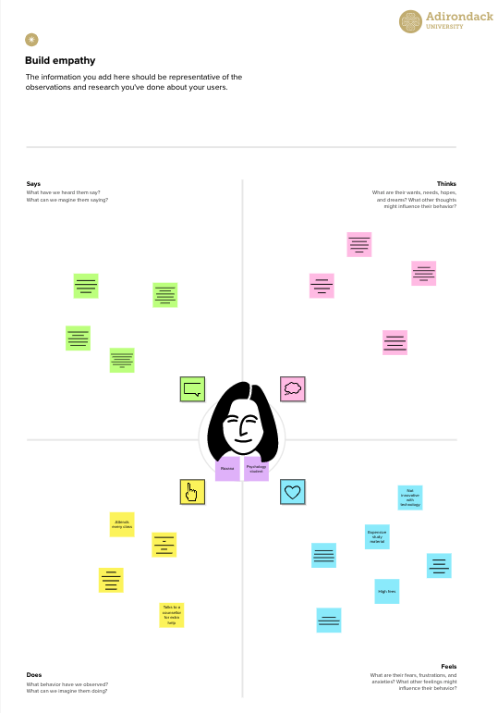




Template
✴
Build empathy
The information you add here should be representative of the observations and research you've done about your users.
Empathy map
Use this framework to develop a deep, shared understanding and empathy for other people. An empathy map helps describe the aspects of a user's experience, needs and pain points, to quickly understand your users’ experience and mindset.
Says
What have we heard them say? What can we magine them saying?
Thinks
What are their wants, needs, hopes, and dreams? What other thoughts might influence their behavior?
The main aim of development is to update as per the demand of time.
What is the main idea of economic freedom?
What are the criteria for the freedom Index?
Developmental goals are necessary to get a better income and other things in life.
What is the economic freedom Index of India?
It causes destruction for famers and the lives of people living nearby.
Give them a name and a portrait to empathize with your persona.
Economic freedom is an indispensable means toward the achievement of political freedom.
The lack of economic freedom could be a very major reason for loss of liberty, liberty of life.
business development
Until economic freedom is attained for everybody, there can be no real freedom for anybody.
Improve economic development
Developing Jobs
Does
What behavior have we observed? What can we imagine them doing?
Feels
What are their fears, frustrations, and anxieties? What other feelings might
influence their behavior?
Share template feedback
Need some inspiration?
See a finished version of this template to kickstart your work.
Open example

